Slide 1
AIR CANVAS & EMOJINATOR

Slide 2
BATCH DETAILS
Parth Sachan | 18BCE2373
Shashank Shukla | 18BCE2522
Mihir Agarwal | 18BCE2526

Slide 3
TABLE OF CONTENTS
01
02
03
04
AIM
INTRODUCTION
PROPOSED SYSTEM
05
06
ARCHITECTURE
IMPLEMENTATION SCREENSHOTS
CONCLUSION

Slide 4
AIM
To make an air canvas for user to draw in air and to make an emojinator which can detect any hand emoji as per user’s action in front of the video feed.

Slide 5
INTRODUCTION
Writing in air has been one of the most fascinating and challenging research areas in field of image processing and pattern recognition in the recent years. It contributes immensely to the advancement of an automation process and can improve the interface between man and machine in numerous applications. Object tracking is considered as an important task within the field of Computer Vision. The invention of faster computers, availability of inexpensive and good quality video cameras and demands of automated video analysis has given popularity to object tracking techniques.

Slide 6
INTRODUCTION contd
The project takes advantage of this gap and focuses on developing an air canvas as well as an emojinator. This project is a reporter of occasional gestures and feelings (through emojis). It will use computer vision to trace the path of the finger or user’s particular action. The air canvas can be used to draw something in the air and can be incorporated into online meeting application where teachers can use it to teach or explain. Emojinator can be used in speech-to-text systems or can be used in chat-based collaboration systems where members can show their reactions in real-time without using the reaction panel.

Slide 7

PROPOSED SYSTEM
AIR CANVAS
EMOJINATOR
Detects any hand emoji imitated by the user in the video feed!
Enables users to draw in air as well as erase! User can choose between multiple colour options as well. User can also clear the canvas at any time.

Slide 8
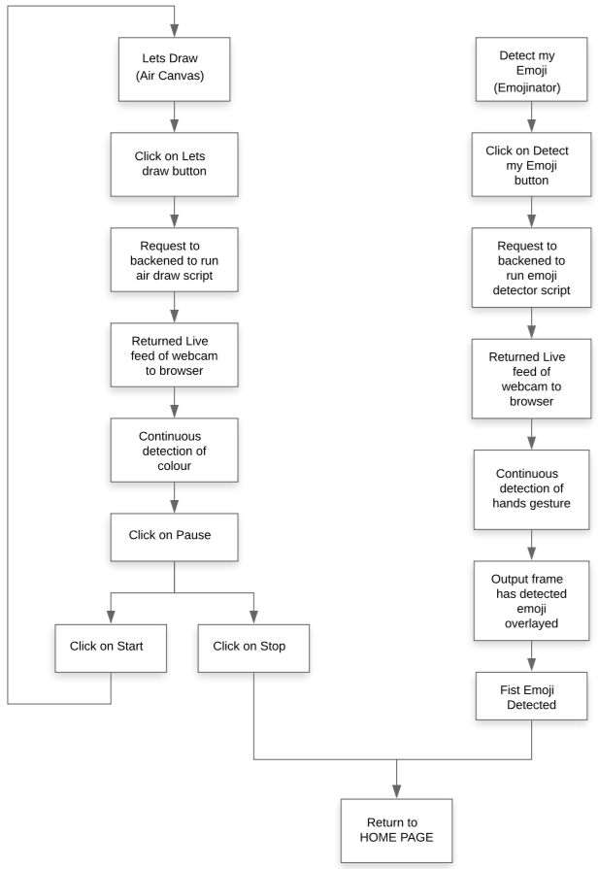
ARCHITECTURE

Slide 9
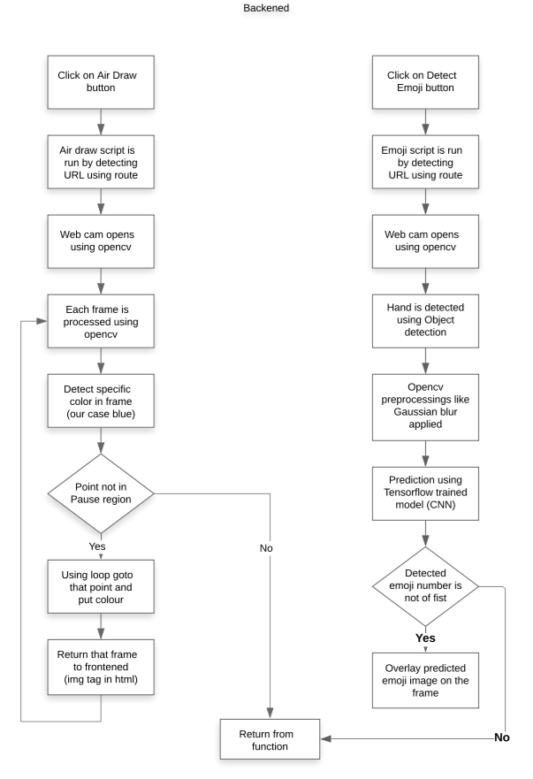
ARCHITECTURE contd

Slide 10
REQUIREMENTS
Hardware
Tech stack
NVIDIA graphics card and
respective drivers
CUDA driver v11.1
(for tensorflow GPU)
cuDNN v8.1
Inbuild webcam
Python v3.9
Flask
openCV
Tensorflow
Keras
HTML
CSS
Bootstrap
Git
Software
VSCode
Any browser
Anaconda

Slide 11
01
IMPLEMENTATION SCREENSHOTS
AIR CANVAS

Slide 12
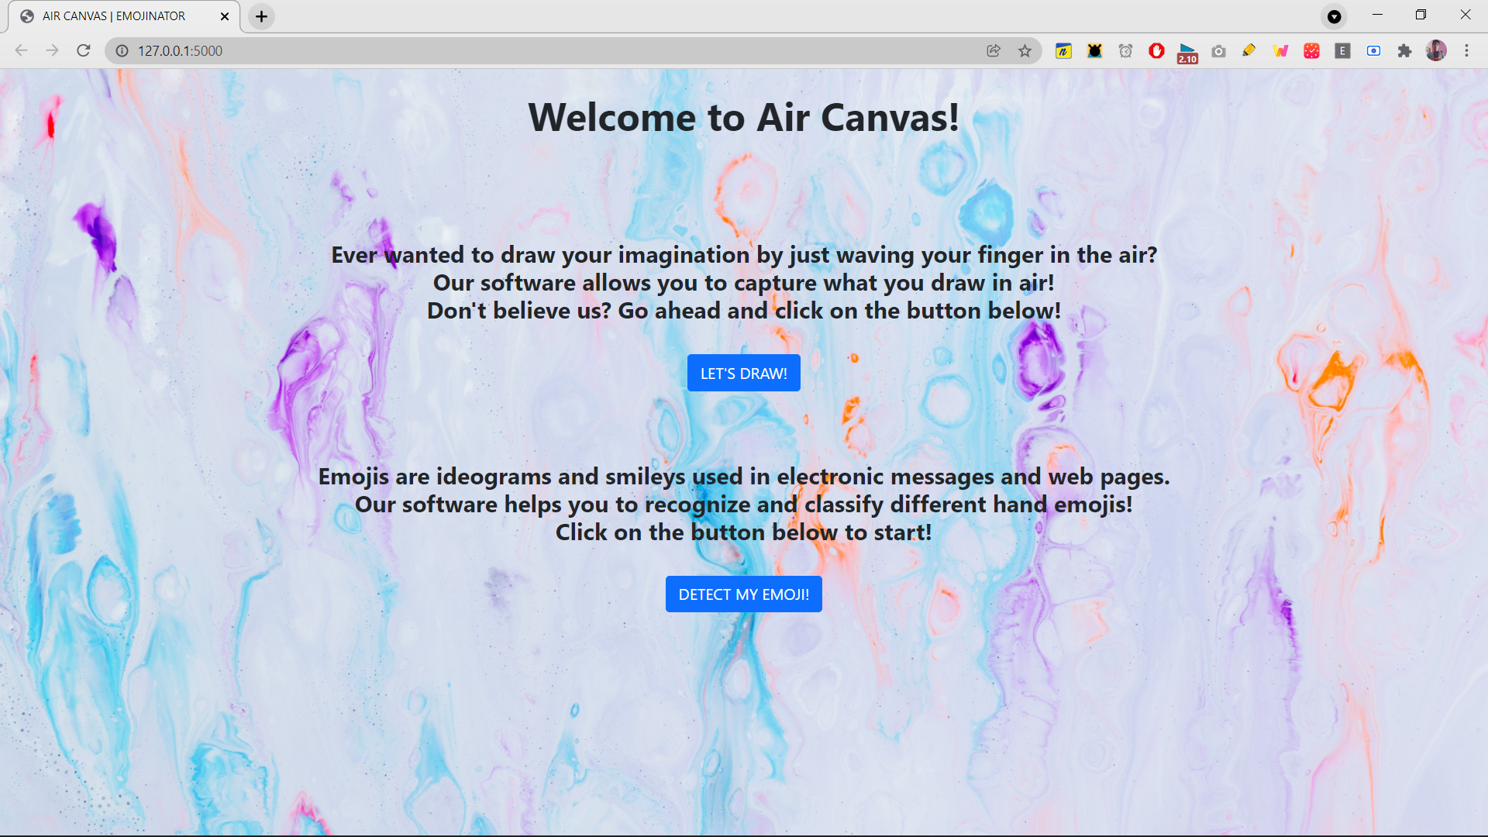

Slide 13
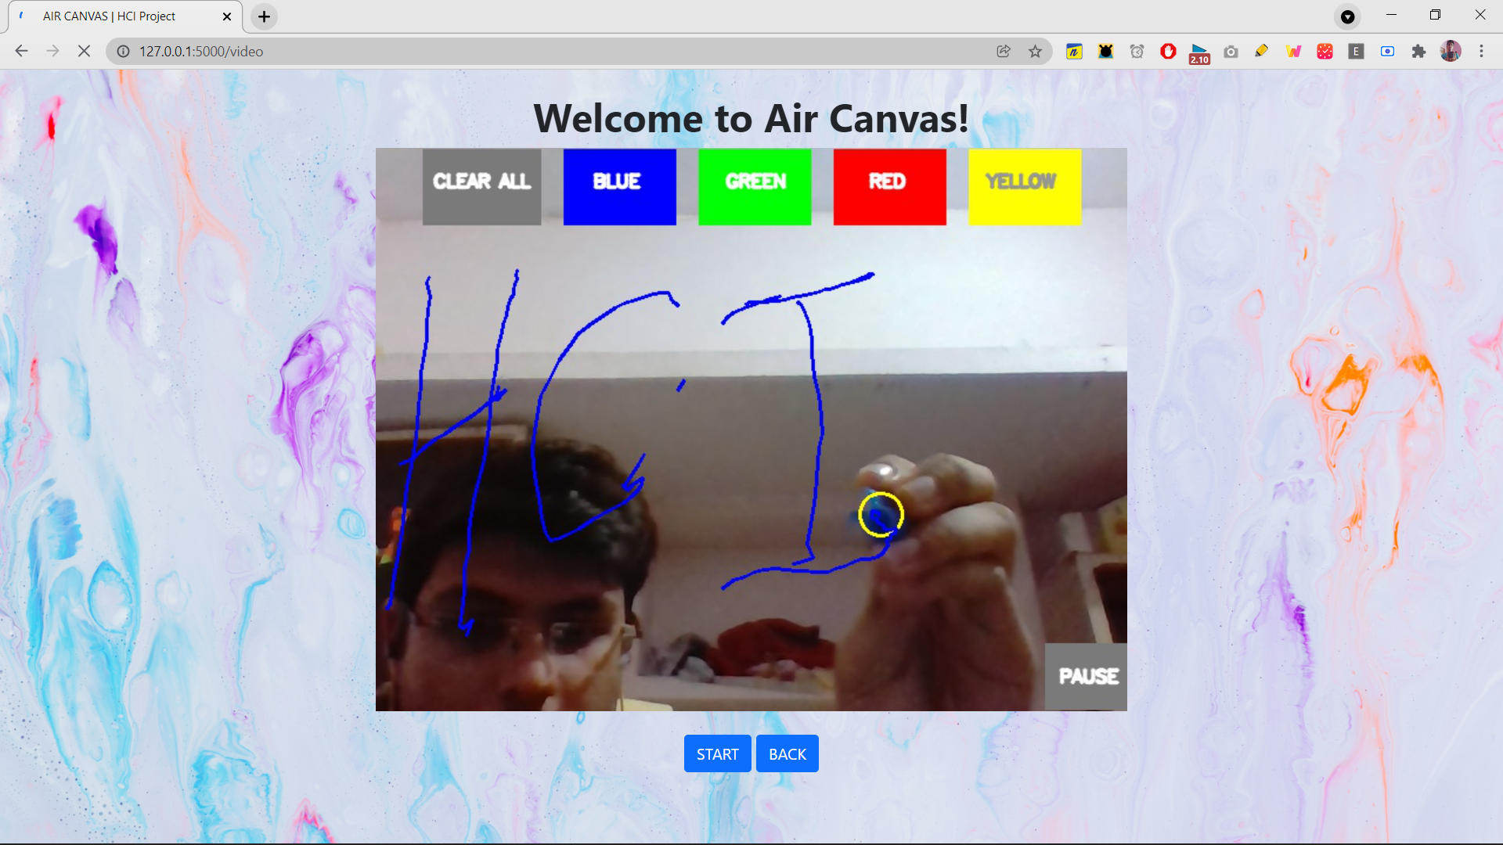

Slide 14
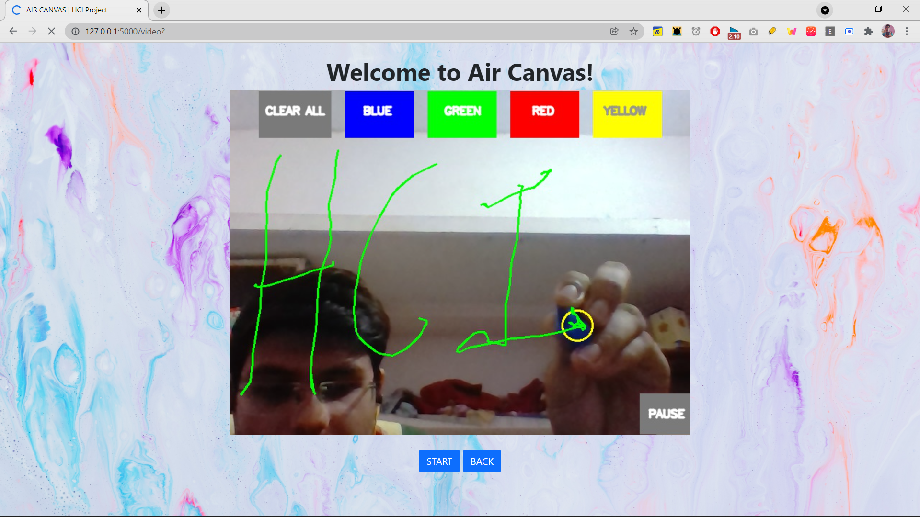

Slide 15
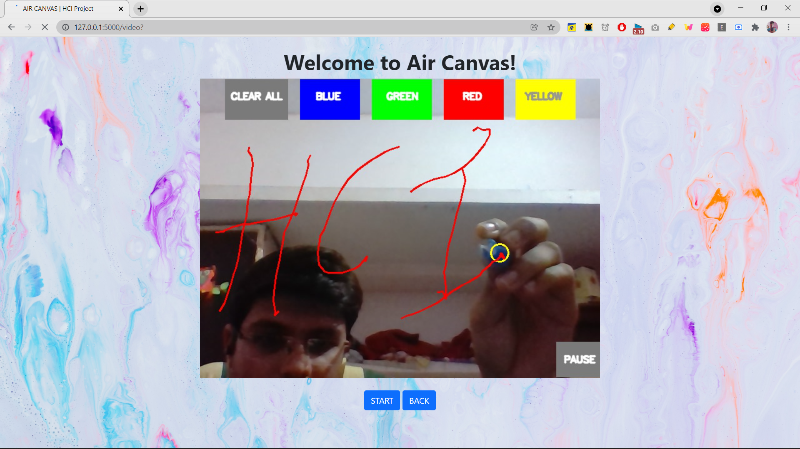

Slide 16
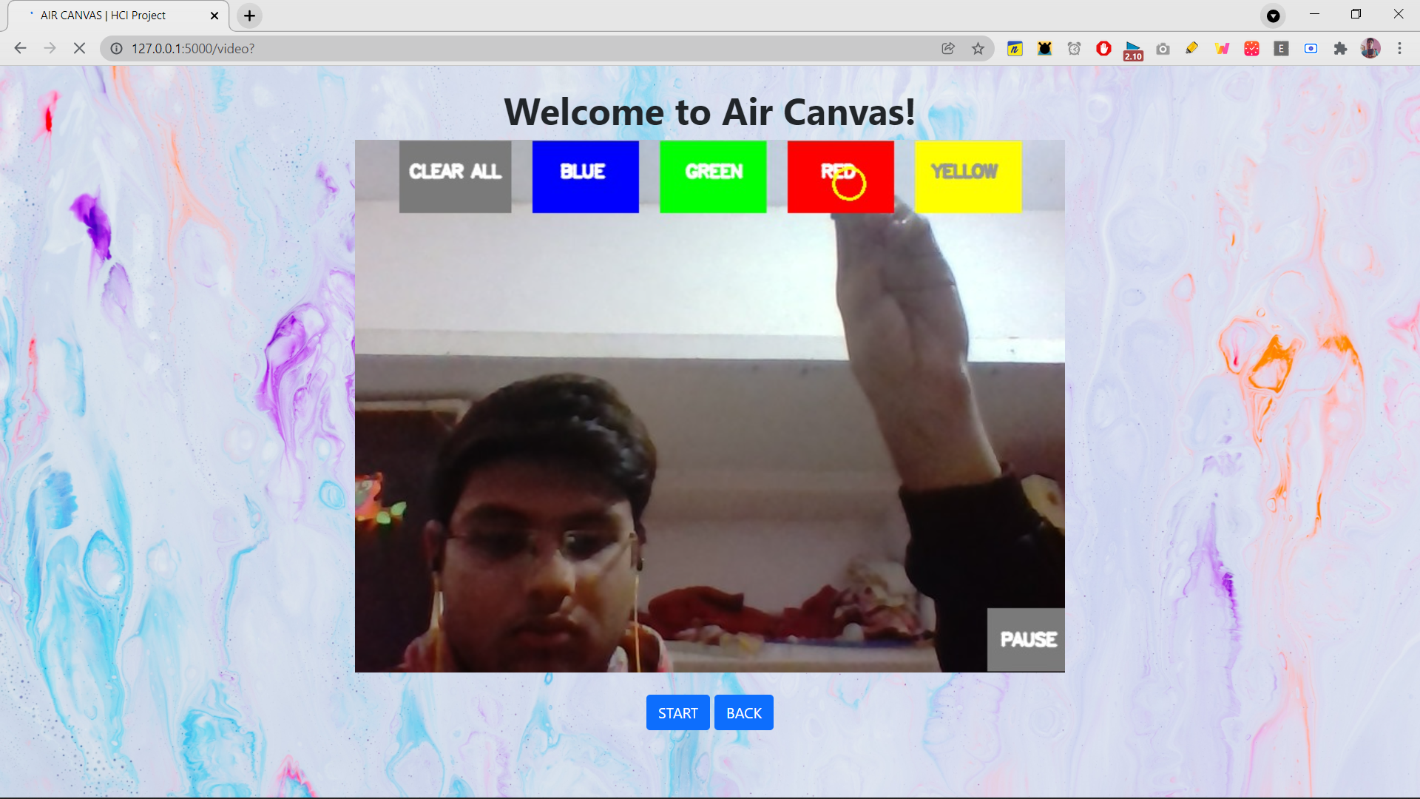

Slide 17
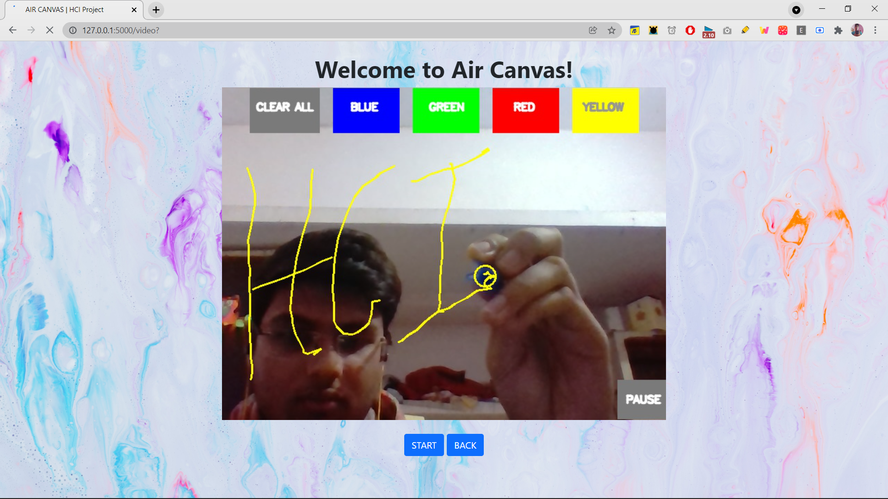

Slide 18
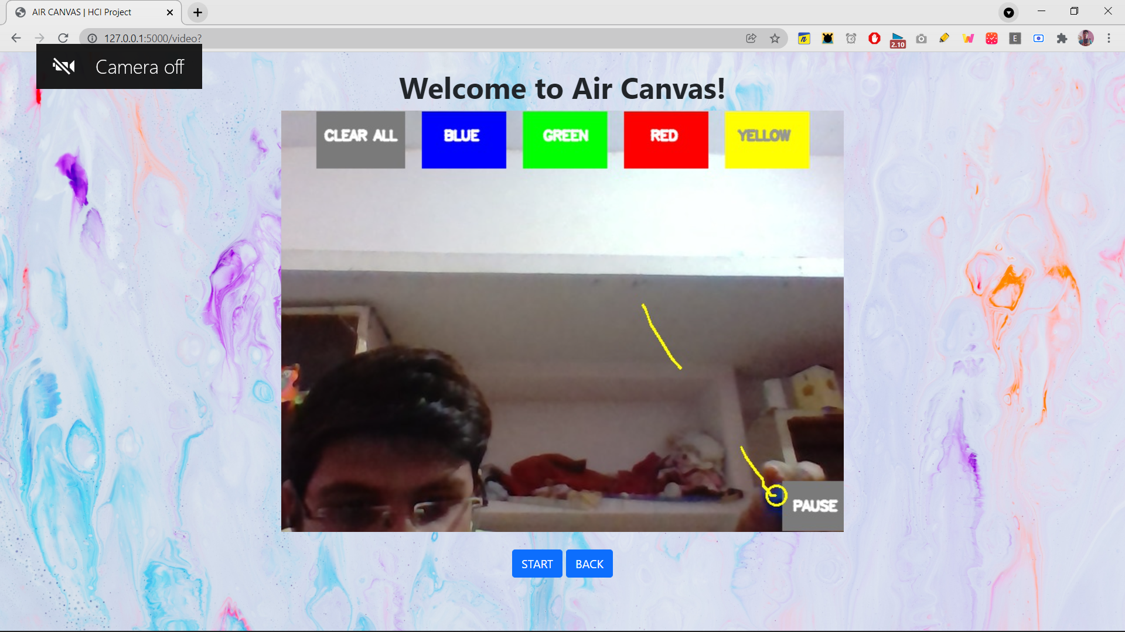

Slide 19
02
IMPLEMENTATION SCREENSHOTS
EMOJINATOR

Slide 20
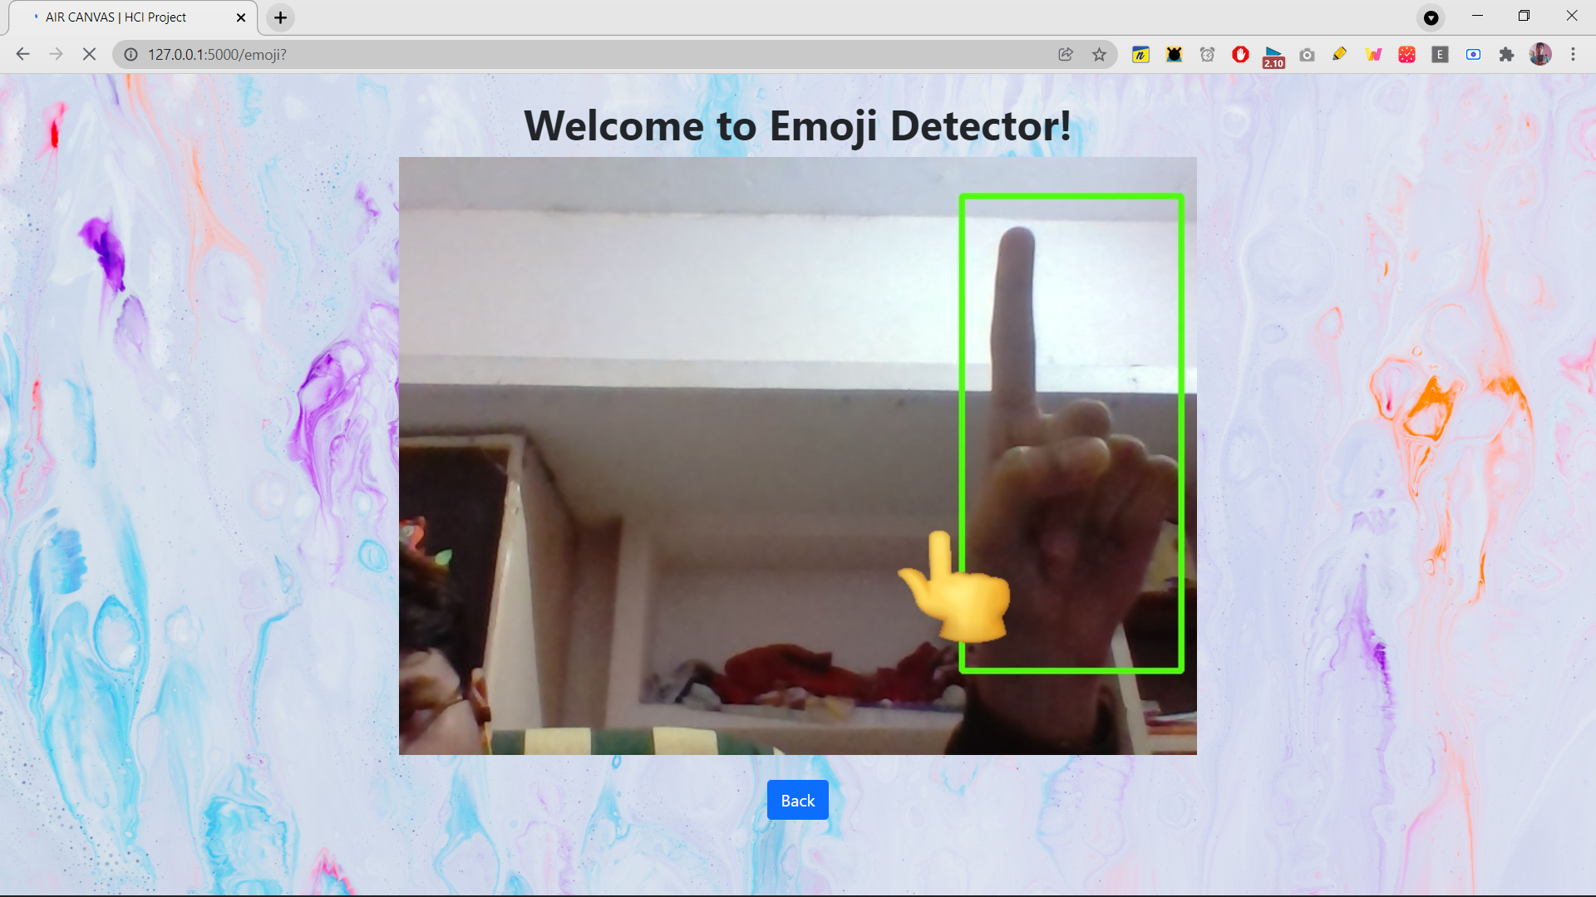

Slide 21
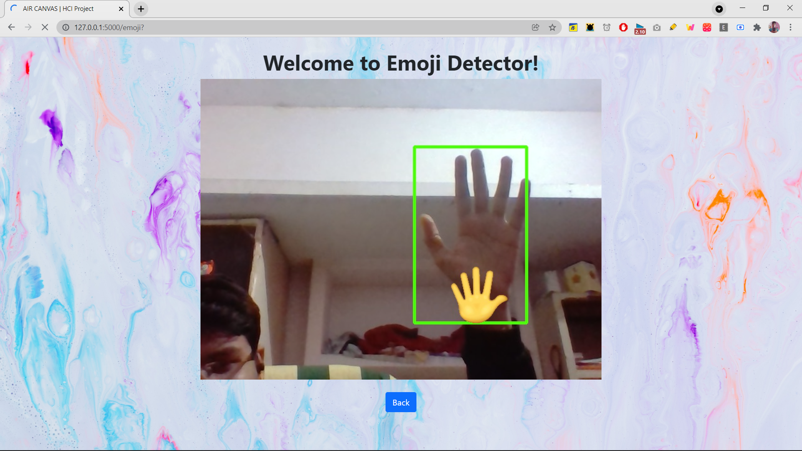

Slide 22
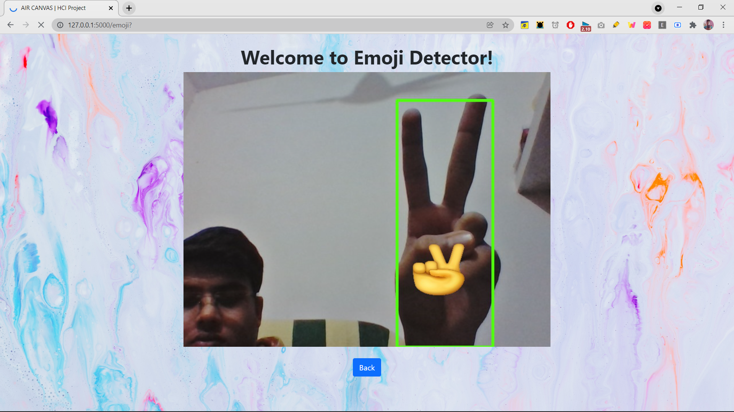

Slide 23
CONCLUSION
The system has the potential to challenge traditional presentation and teaching methods. It will also serve a great purpose in helping especially abled people communicate easily. Even senior citizens or people who find it difficult to use keyboards will able to use system effortlessly. Extending the functionality, system can also be used while video calls shortly. The system will be an excellent software for smart wearables using which people could better interact with the digital world.

Slide 24
THANK YOU!

